Slide 1

Electrospinning of Oxygen-less Polymers to Fabricate Carbon-based Nanostructures
A Osamu Katagiri Tanaka A01212611 - osamu.katagiri@exatec.tec.mx
22 Oct 2019

Slide 2
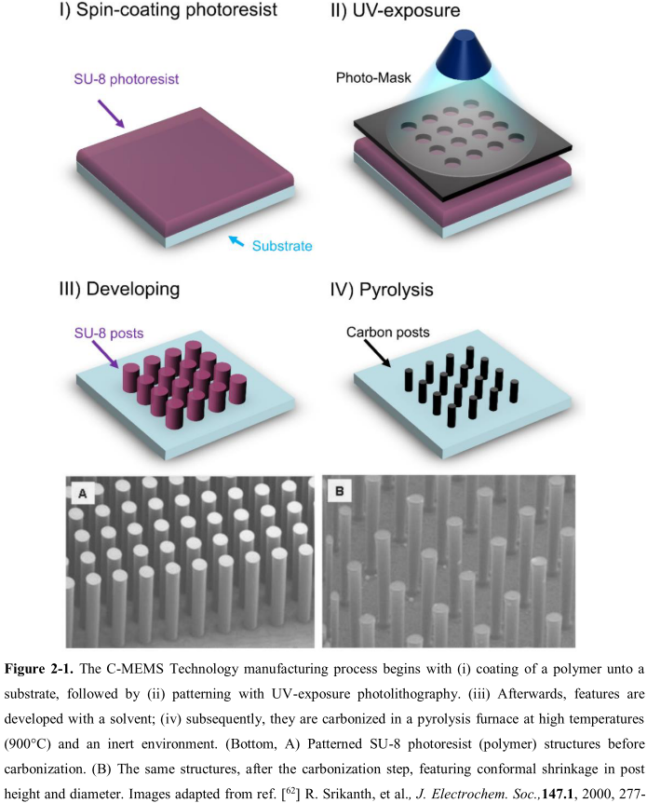
Previous work
The production of C-MEMS:
Polymer patterning through photolithography electrospinning
Carbonization through pyrolysis
● SU-8 Waste
● Physical & Optical Limitations
● Structure Limitations
photolithography process

Slide 3
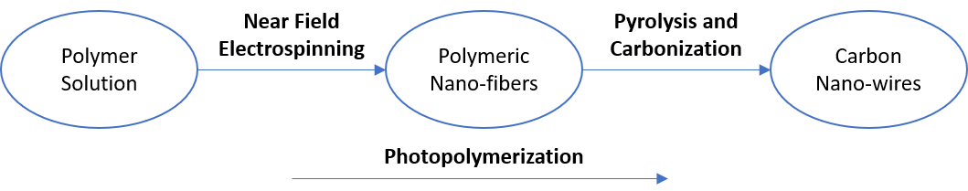
CNW Fabrication Process
Design polymer solutions that can be electrospun by NFES, photopolymerized, and then pyrolyzed into carbon nano-wires.

Slide 4
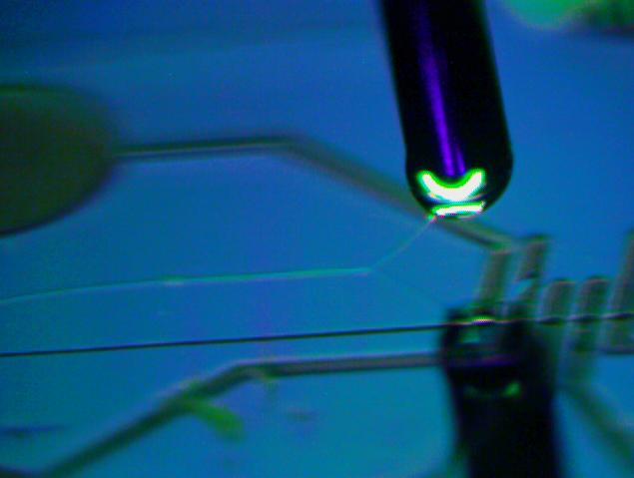
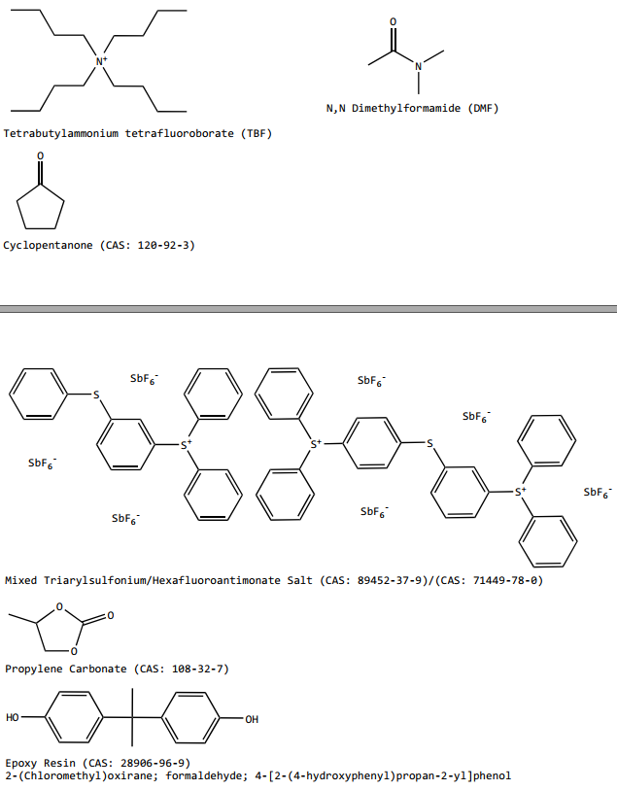
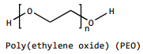
Polymer Solution used by Braulio & Ricardo
wt% PEO 0.25 | SU-8 2002 [mg] | PEO [mg] | TBT [mg]
 | 2246 | 5.65 | 11.32
= 2 ml of solution
Increase the solution conductivity
Provided the required viscoelasticity
… both needed for smooth PEO flow during electrospinning
Notes:
Surface t-

Slide 5
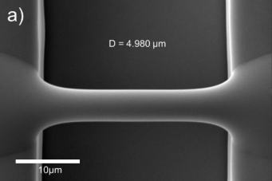
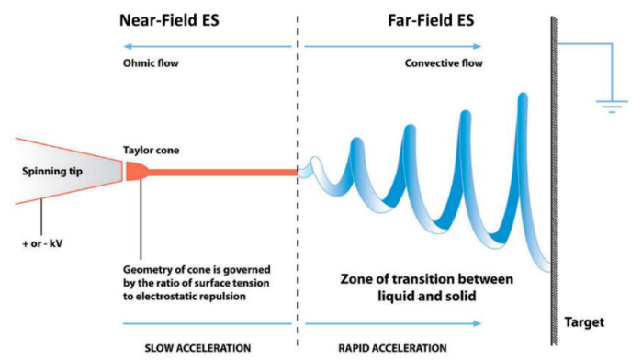
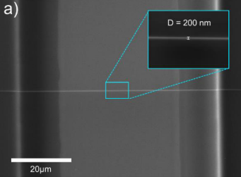
Best Results so far
Fiber yield rate of 81 %
Fiber diameter before pyrolisis of 4.966 μm
Fiber diameter after pyrolisis of 204 nm
Fiber length of 60.5 ± 4.3 μm
Fiber resistivity from 407 KΩ to 1.727 MΩ

Slide 6
Implications of PEO, as it introduces oxygen to the solution
The fiber yield rate and fiber conductivity are impacted negatively.
Some samples are destroyed during pyrolysis
High variance in the obtained conductivity across samples.
In the presence of oxygen, the char yield decreases. This is due to the oxidation on the char.
Notes:
Surface t-

Slide 7
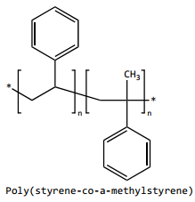
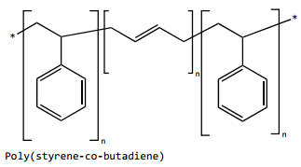
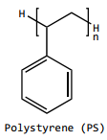
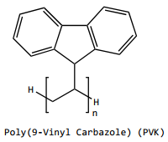
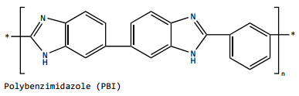
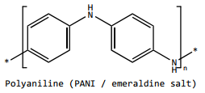
Next step: Discover a new polymer solution to beat Braulio’s record
Study solutions with high carbon polymers and no oxygen.
14 wt% in THF & DMF (Reneker, 1999)
No records
35 wt% in THF (Megelski, 2002)
● FFES
● NFES
No records
12.5 wt% in NMP (Raeesi, 2009)
3.96 wt% in Styrene (Min, 2013)

Slide 8

Q&A

Slide 9
References
Cárdenas, B. (2017). Advanced Manufacturing Techniques for the Fabrication and Surface Modification of Carbon Nanowires, 160.
Flores, D. R. (2017). Role of rheological properties in near field electrospun fibers morphology, 130.

Slide 10
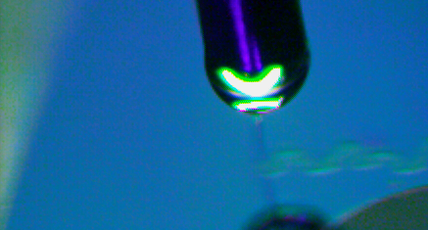
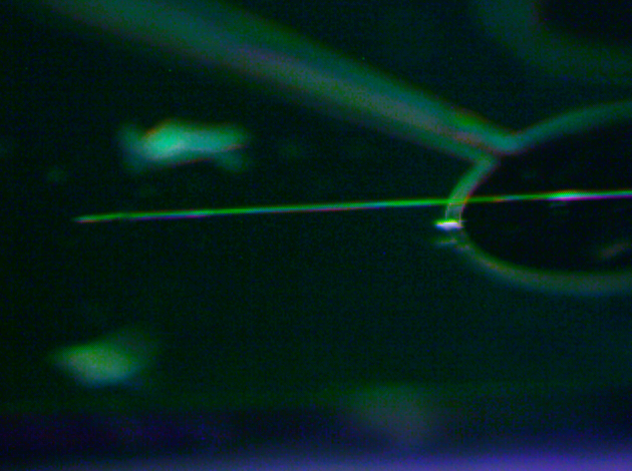
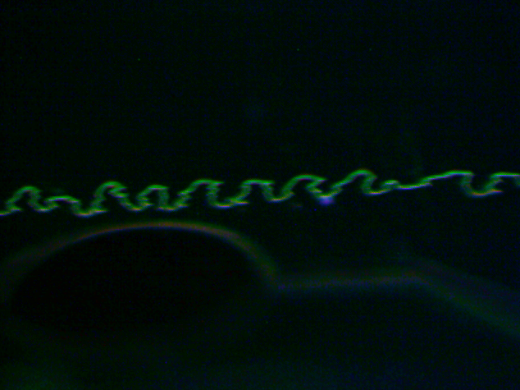
Characterization of the 0.25 wt% PEO Solution
Electrospun-able with an applied voltage of 600V.
Unable to initiate the jet at 500V or lower.
600V
700V
Notes:
Surface t-

Slide 11
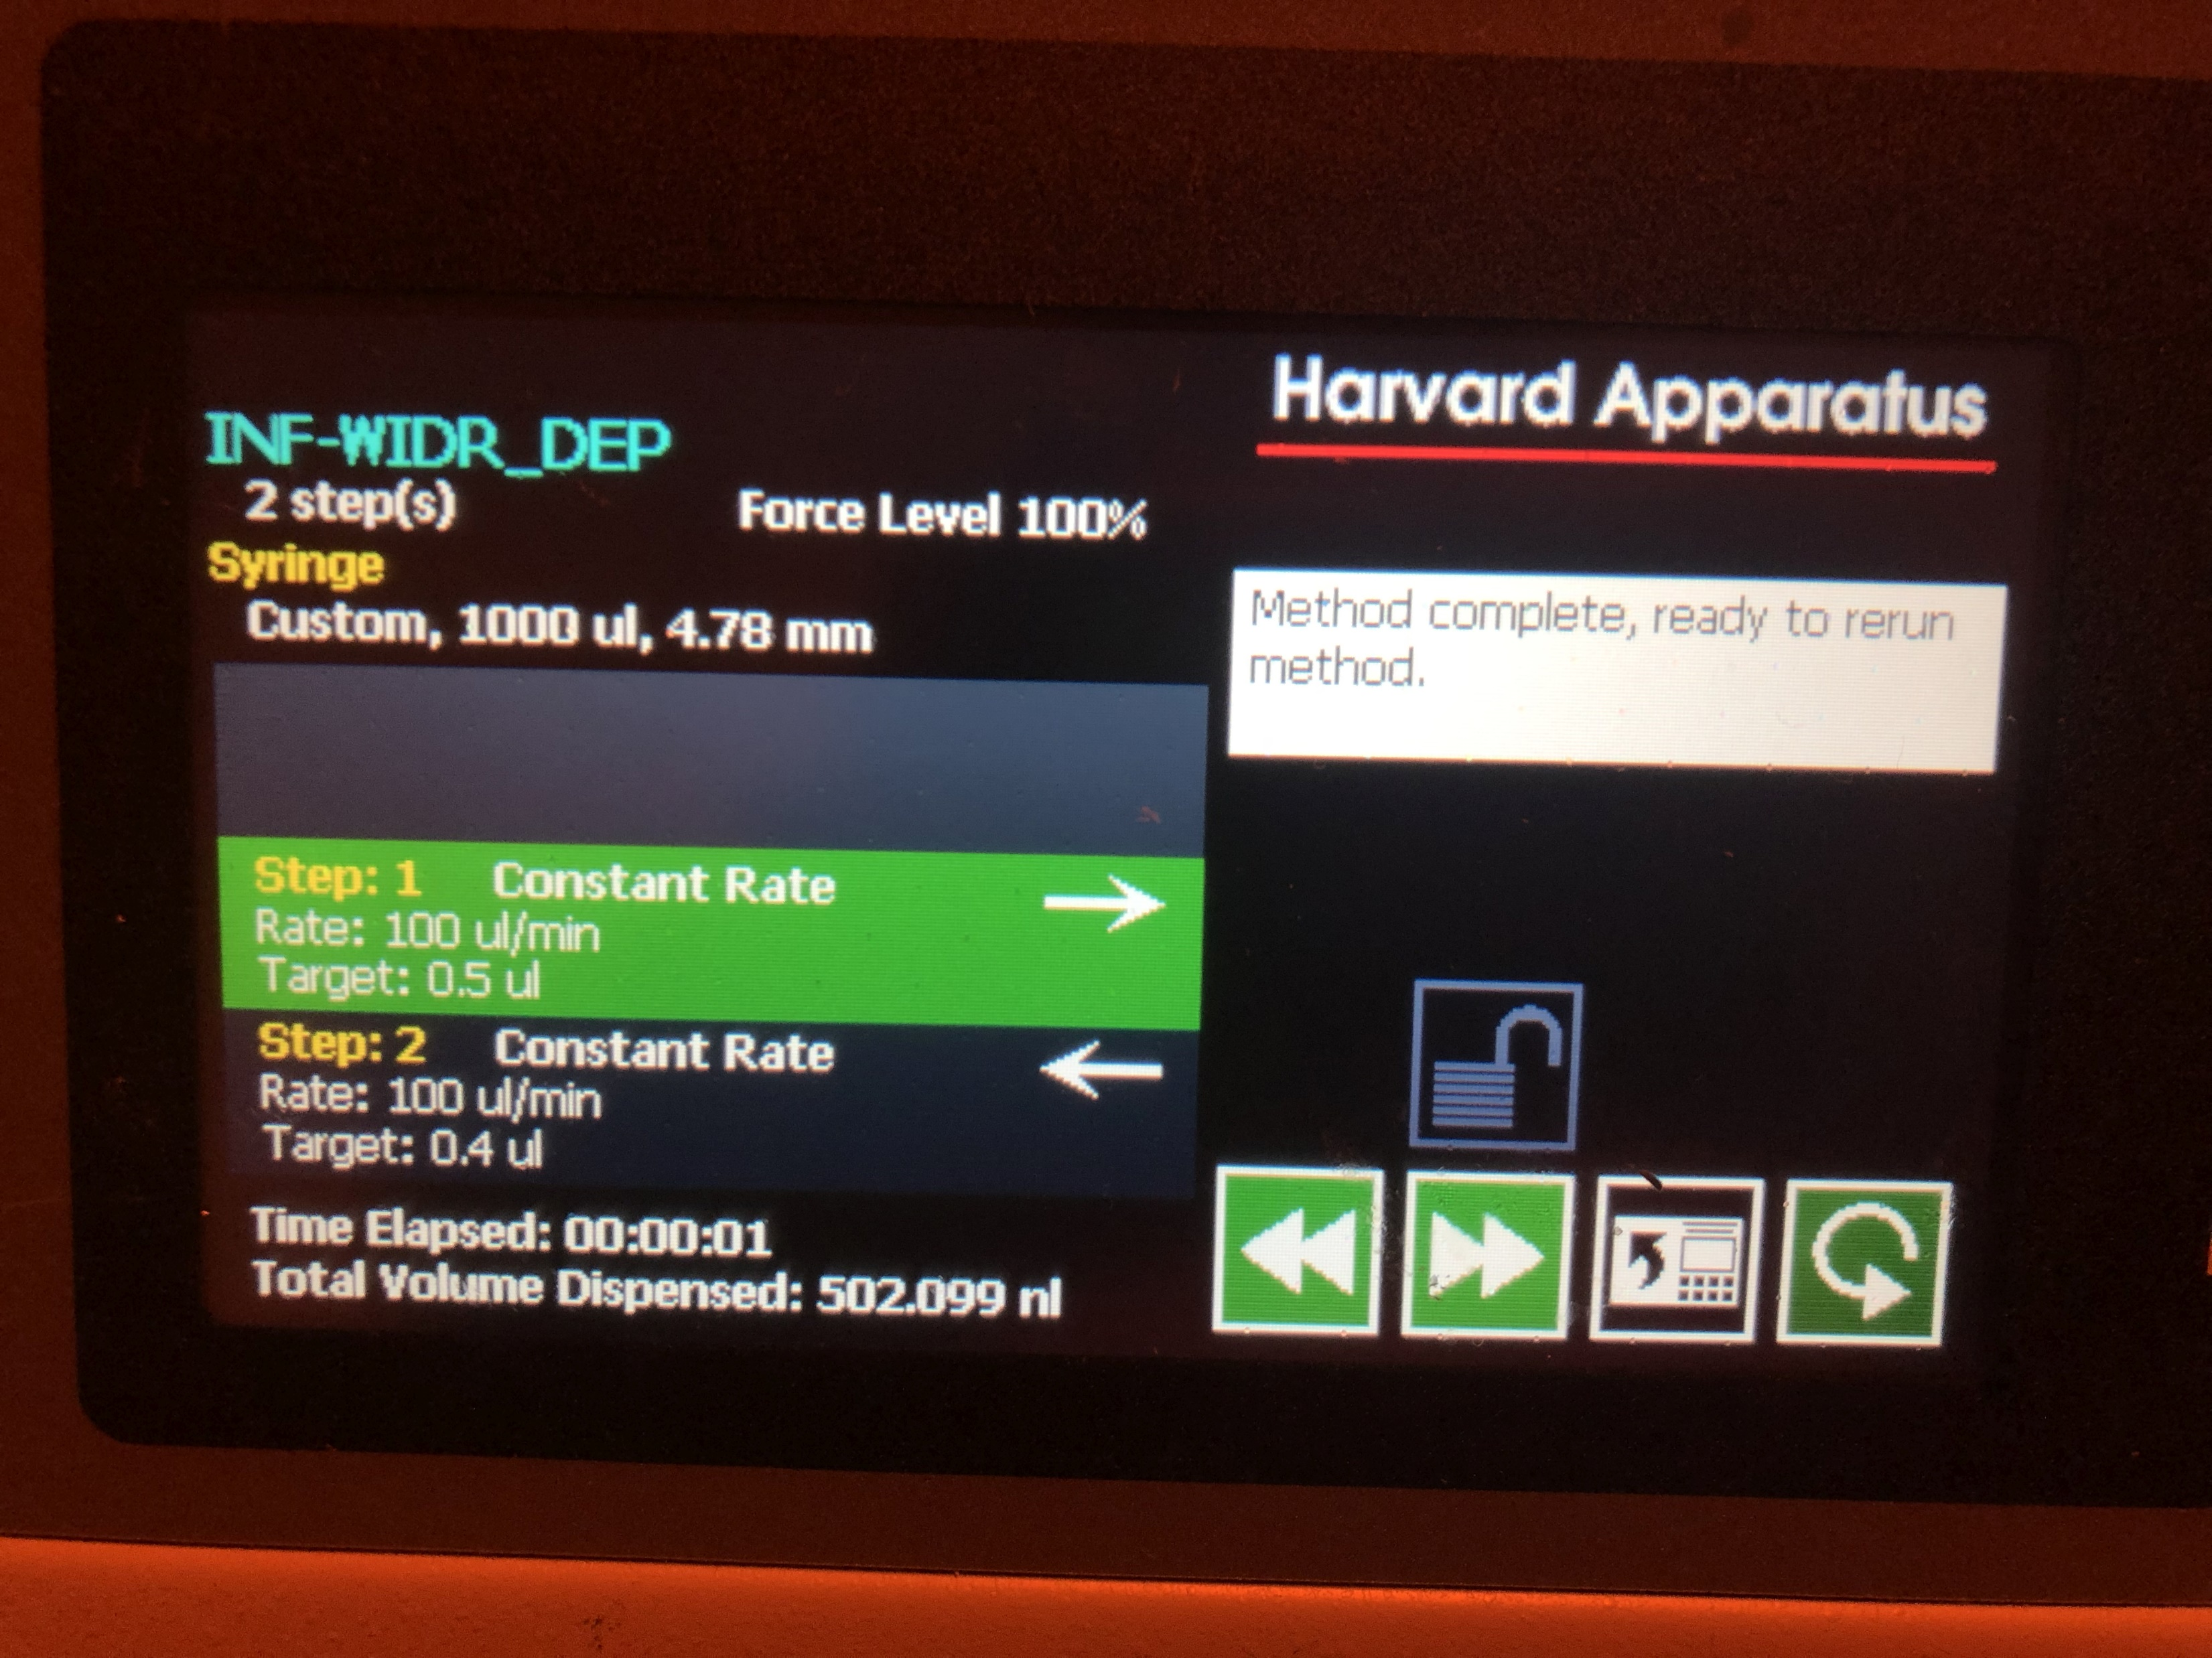
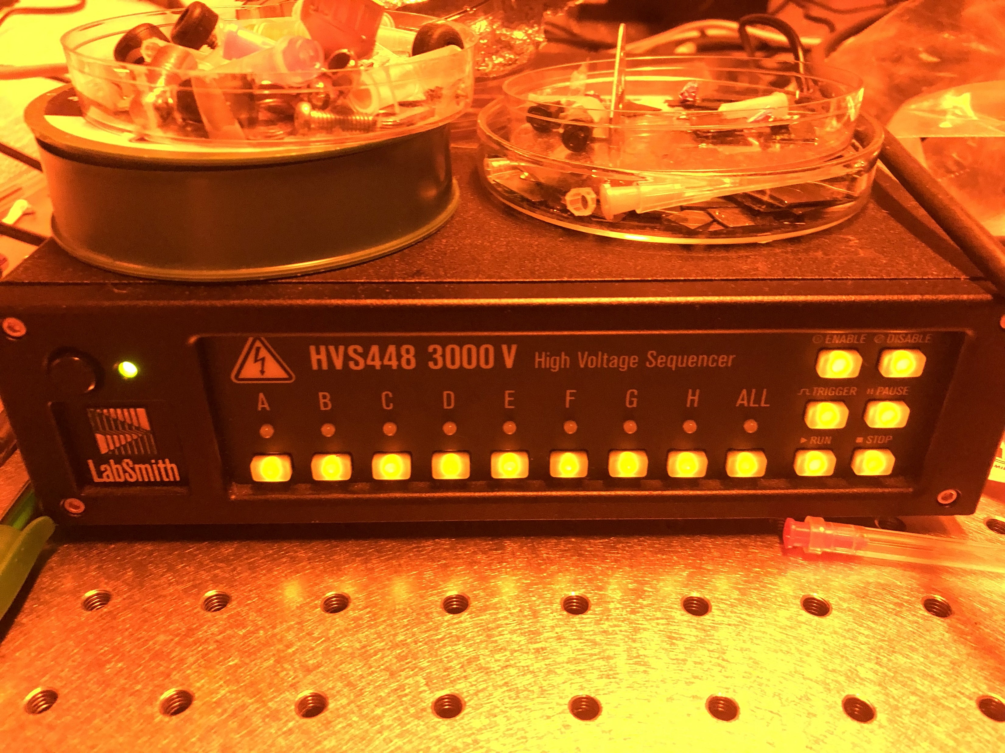
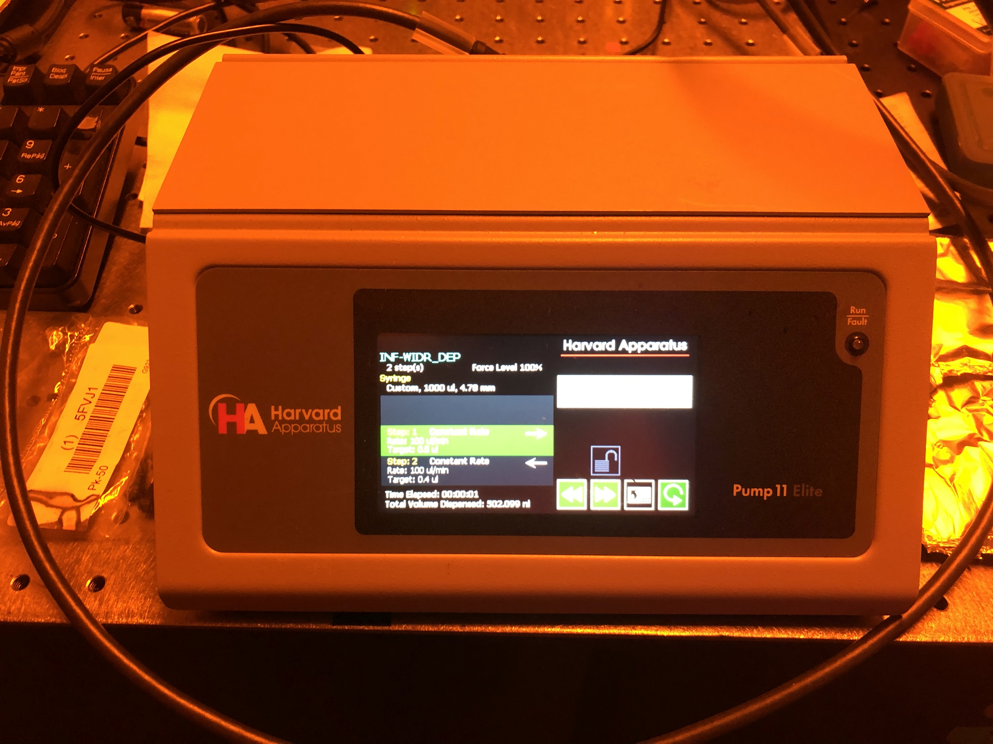

Slide 12
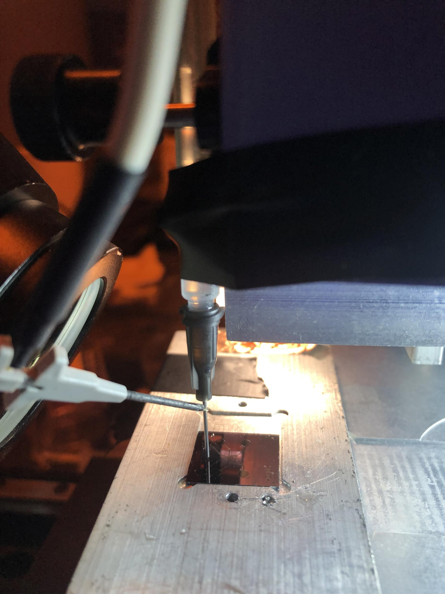
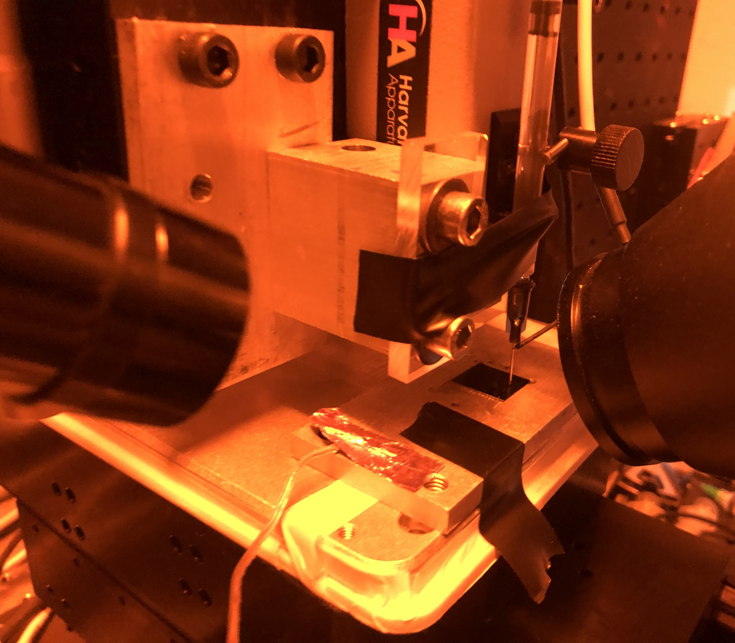

Slide 13
PEO Solution
The EMS polymer solution consisted of
2ml of SU-8 2002 mixed with
0.5 wt% of Poly(ethylene oxide) (PEO, 4,000,000 MW; SigmaAldrich Inc., Cat. N. 189464) and
0.5 wt% Tetrabutylammonium Tetrafluoroborate salts (TBATFB; SigmaAldrich Inc., Cat. N. 217964) to increase its conductivity and allow smooth polymer flow during electrospinning.
All reagents were used as received. Magnetic stirring of these components was performed for 1hr at 75°C and low rpm (100-150 rpm).

Slide 14
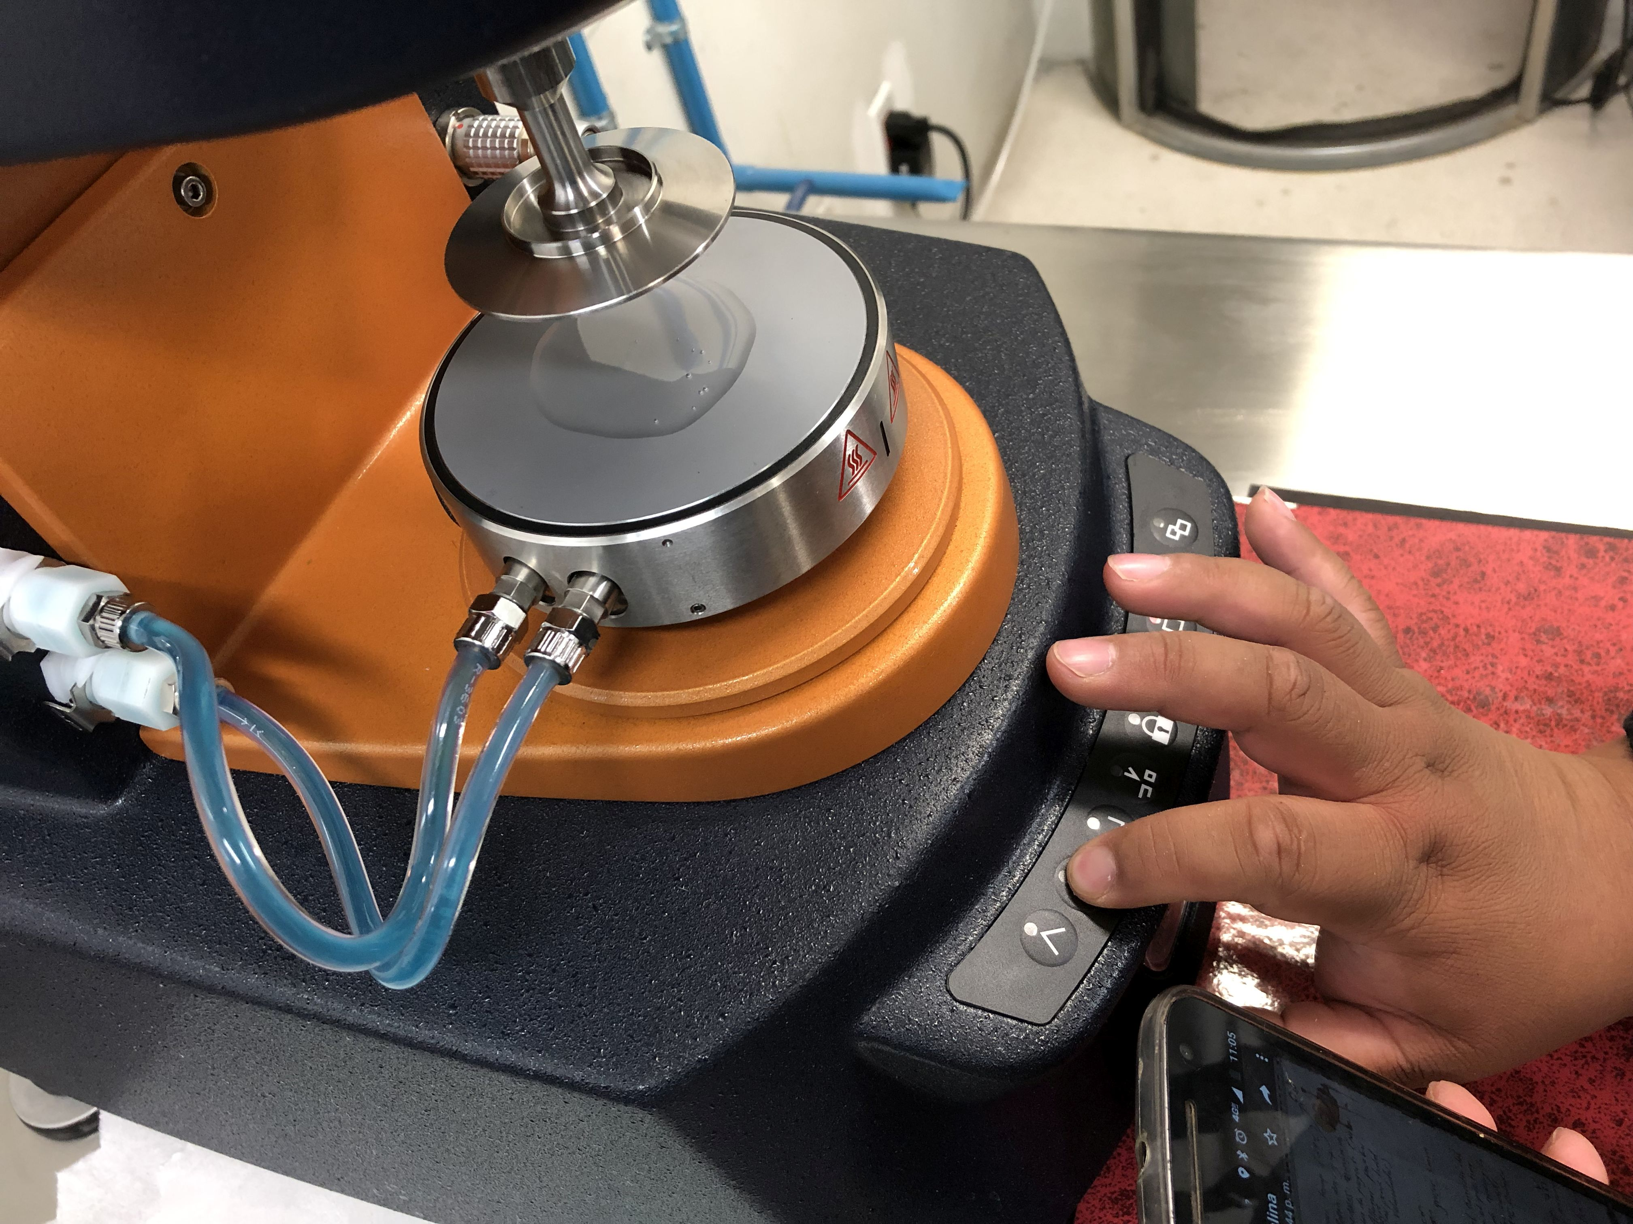
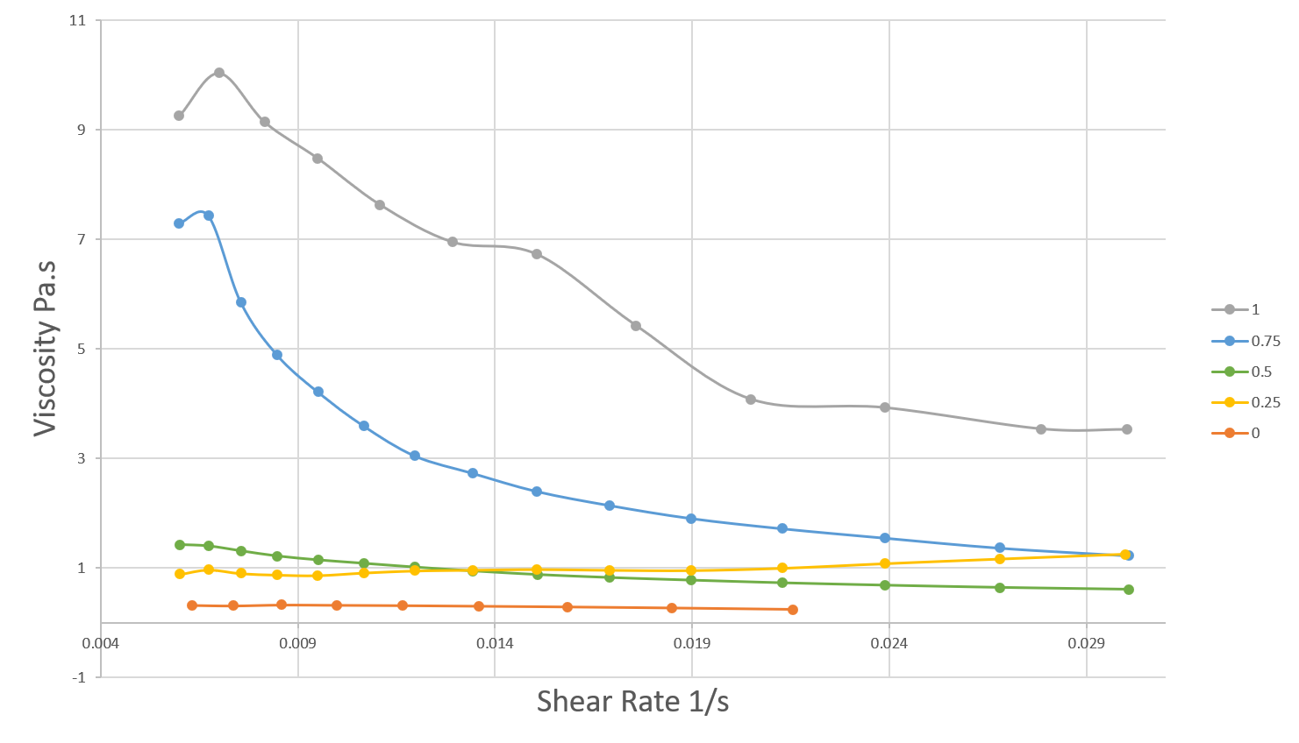
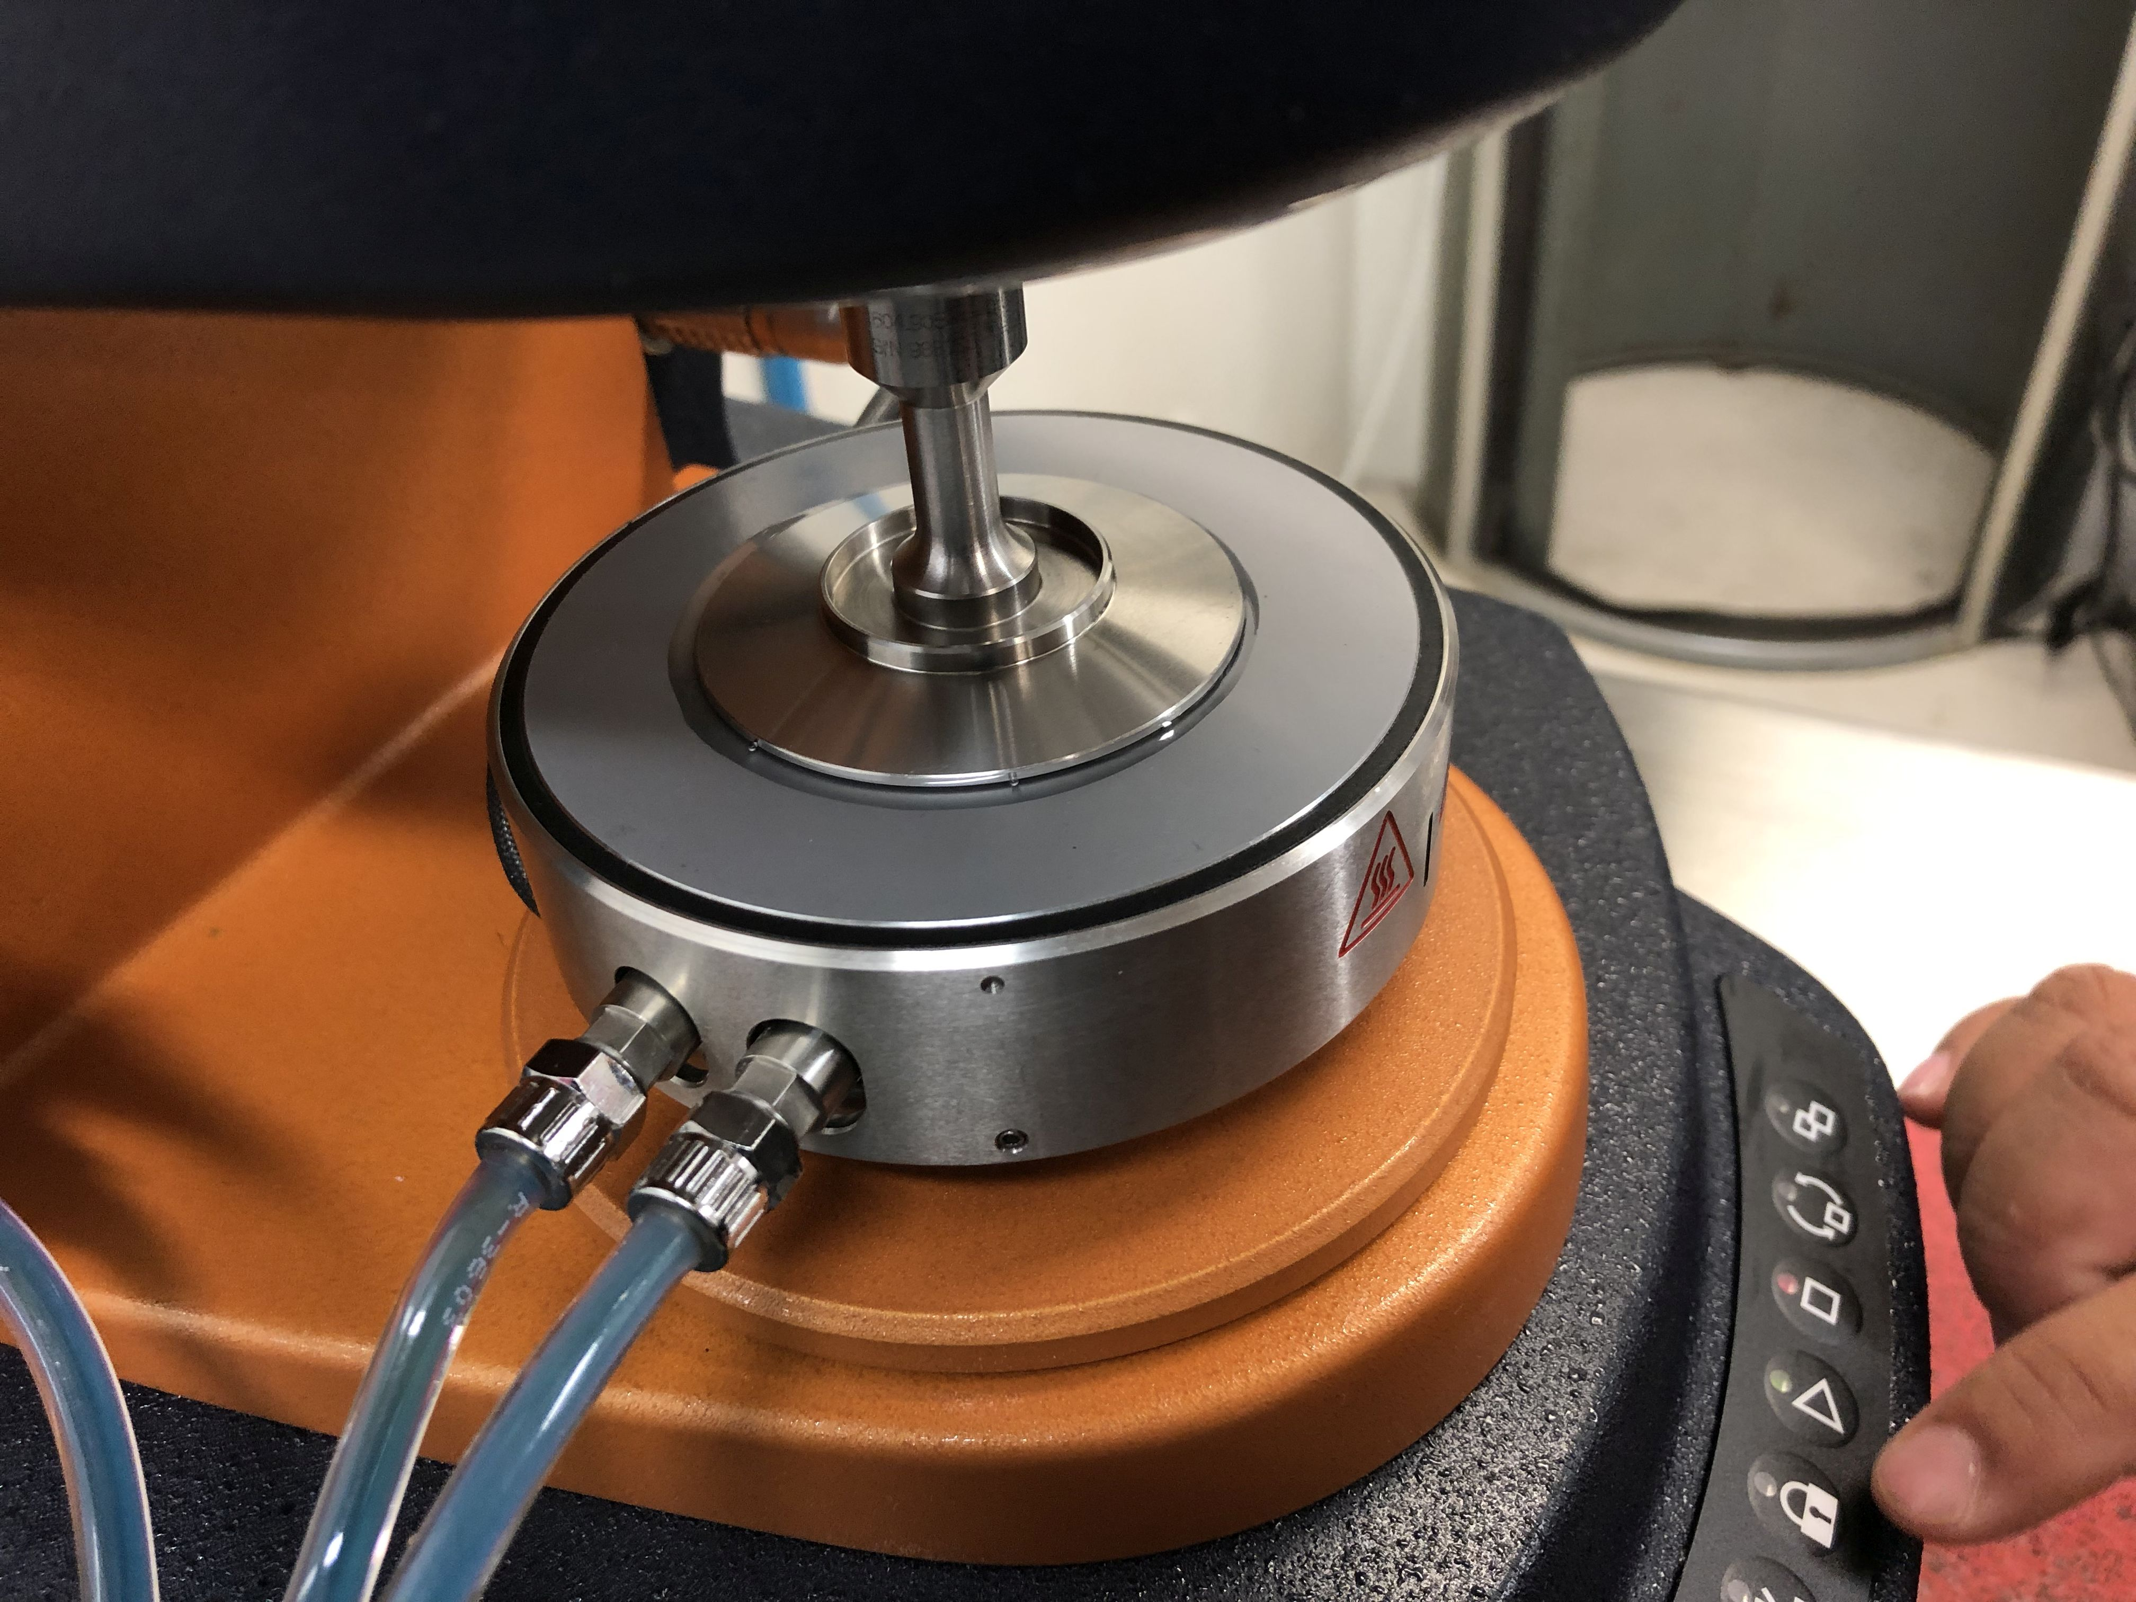
Characterization of the 0.25 wt% PEO Solution
With zero shear viscosity of 0.88 Pa.s.
Notes:
Surface t-

Slide 15
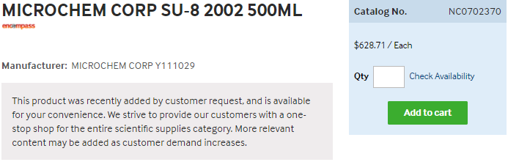
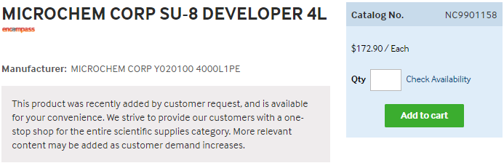
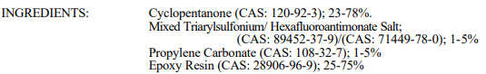
https://www.fishersci.com/shop/products/NC0702370/nc0702370#?keyword=MICROCHEM+CORP+PHOTORESIST+SU-8
https://www.fishersci.com/shop/products/NC9901158/nc9901158#?keyword=SU-8++developer
Notes:
https://rsc.aux.eng.ufl.edu/_files/msds/309.pdf

Slide 16
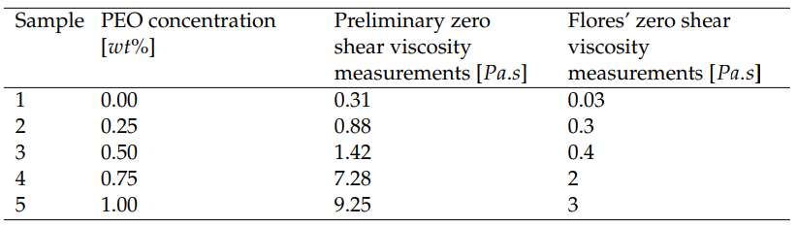
Zero shear viscosity measurements and Flores’ measurements
Both measurements have the same behaviour with similar proportions.
However, the results show that the current measured values are approximately three times larger than Flores’ measurements.

Slide 17
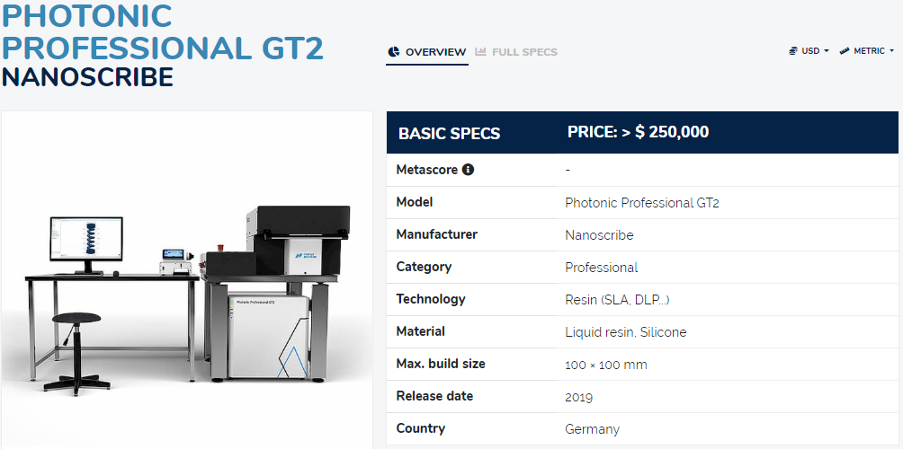
2PP Instrumentation

Slide 18
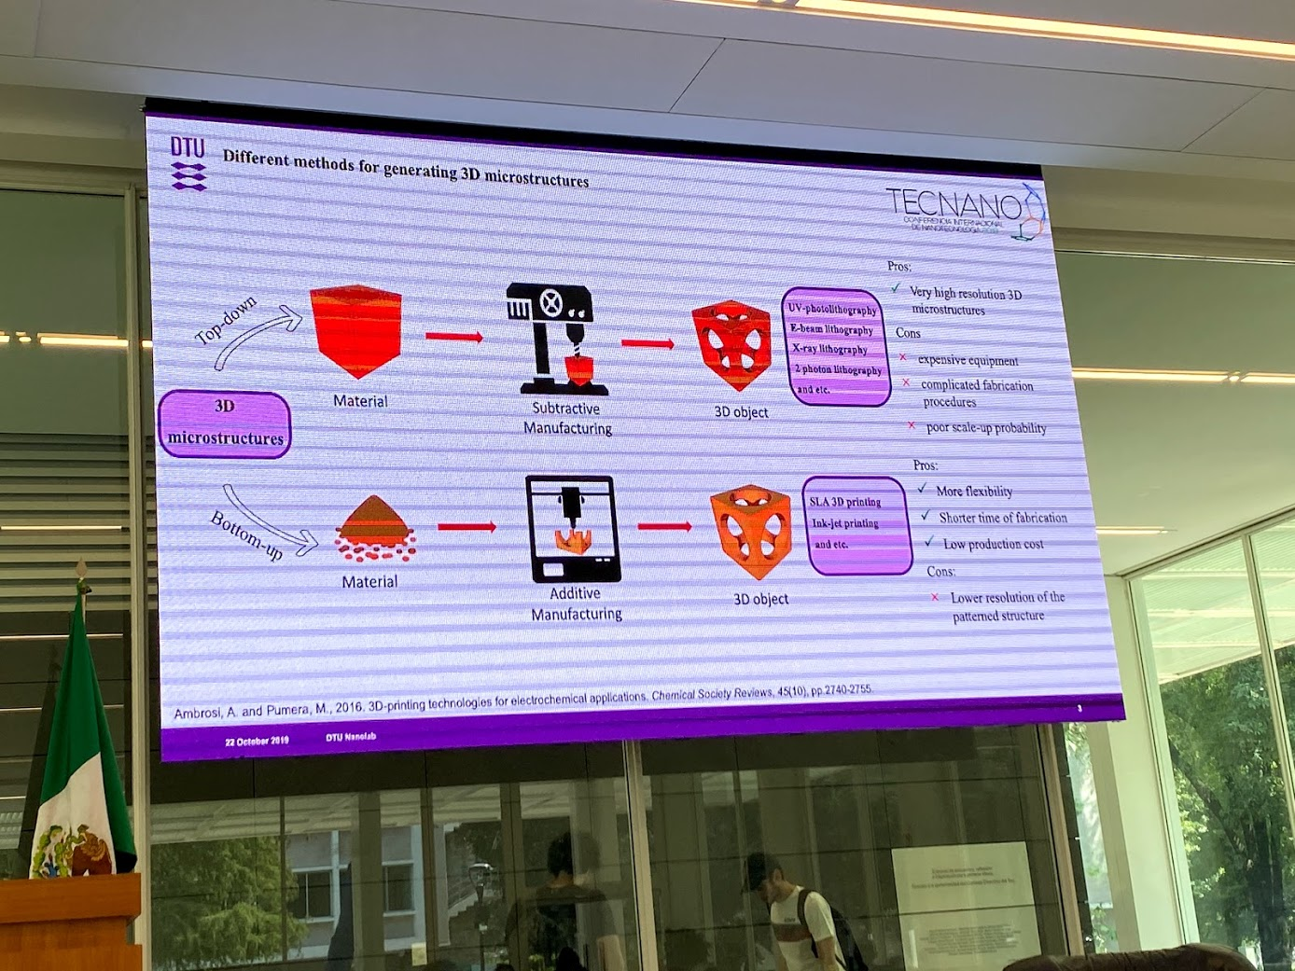

Slide 19
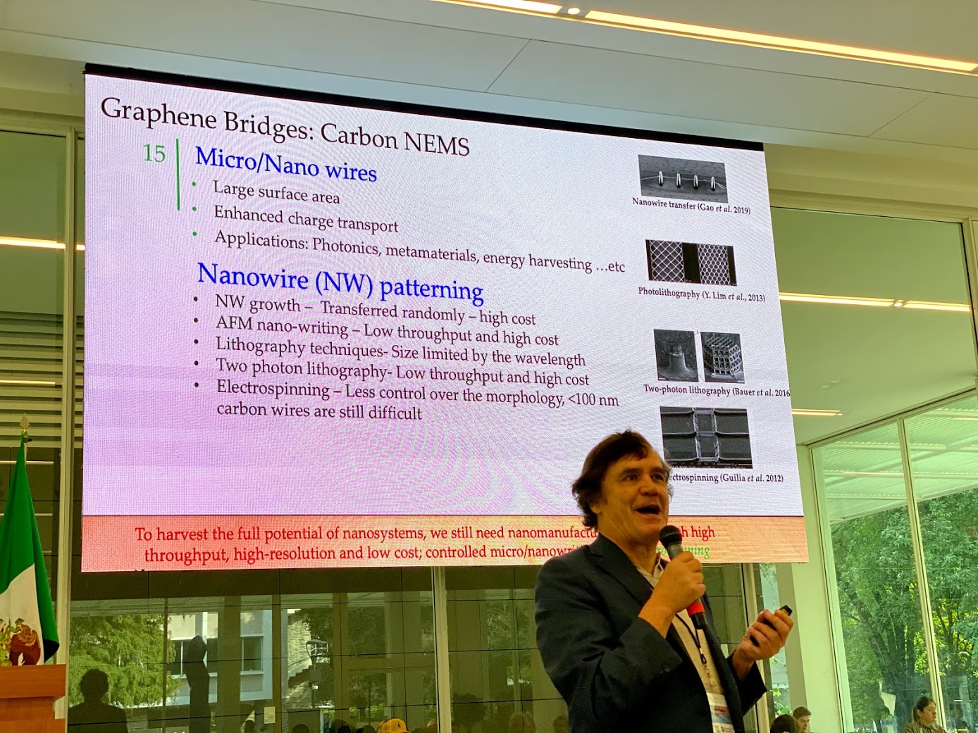

Slide 20
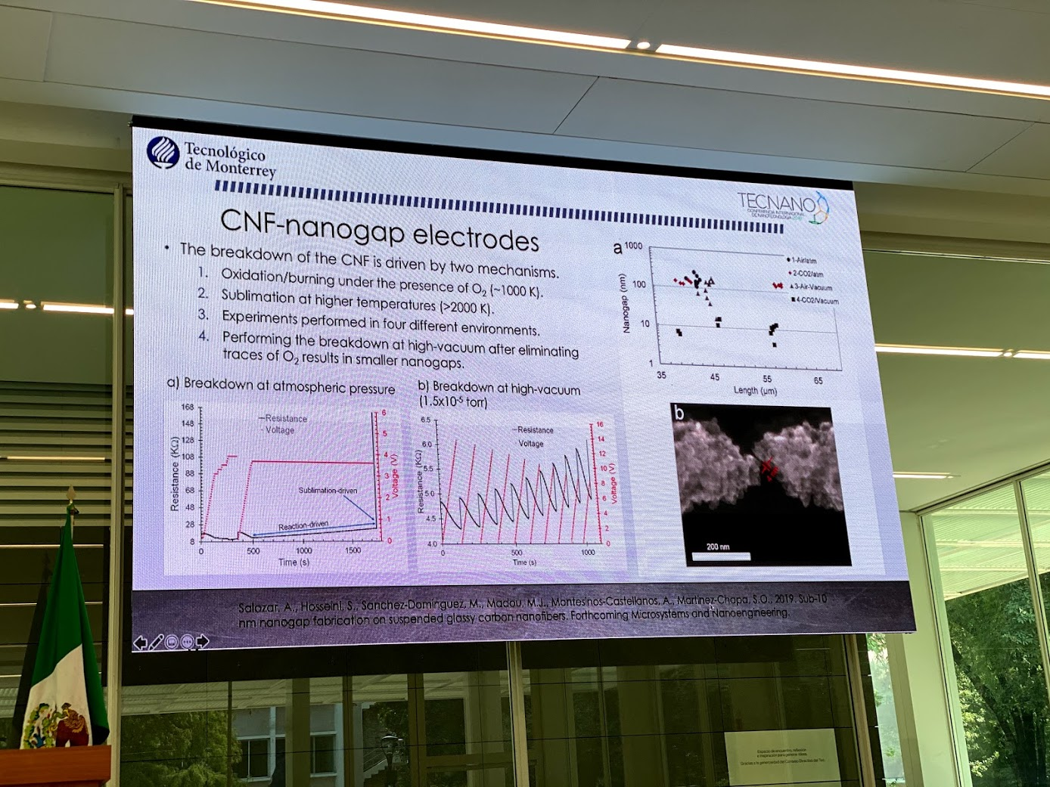

Slide 21
<subTitle>
<content> <key concept>

